Slide 1
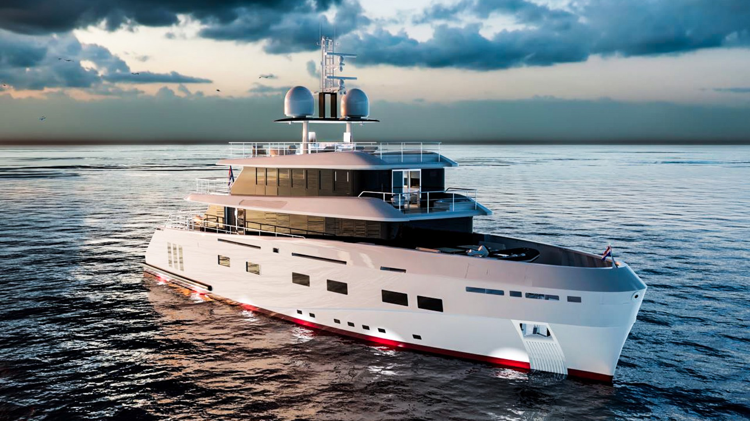
RENATA
CERRI CANTIERI NAVALI (CCN)

Slide 2
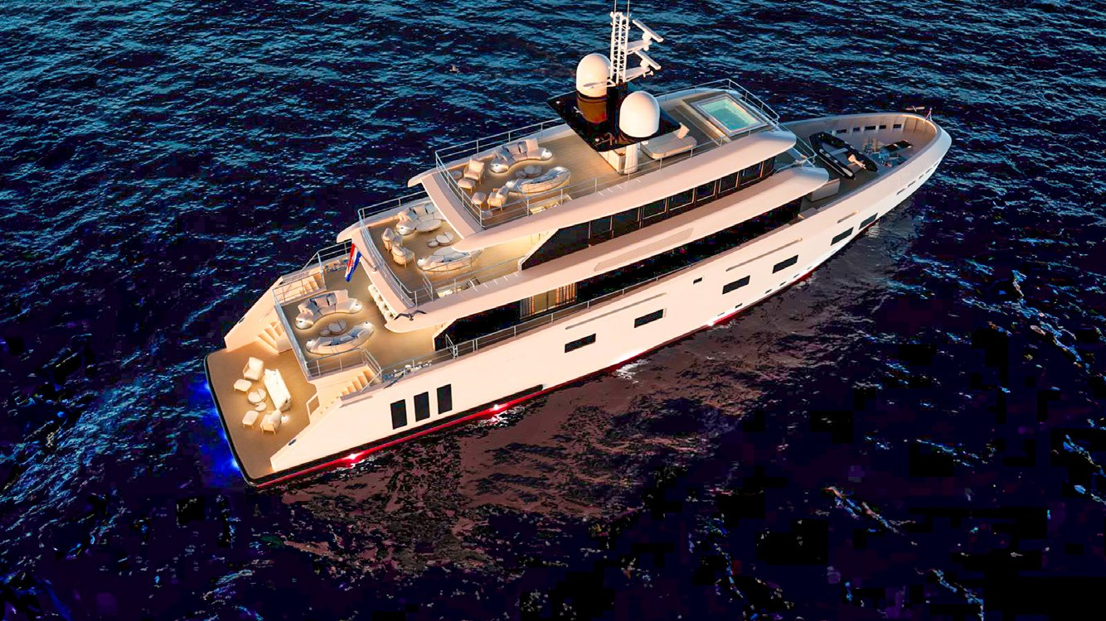
RENATA ~ CCN
Loa 40.80 m (133’ 10”) Beam 9.00 m (29’ 6”) Draft 2.6 m (8’ 6”) Built 2025 Refit 2025 Guests 12 Crew 9
Naval Architect Studio Sculli Hull Material Steel Hull Configuration Displacement Superstructure Flybridge

Slide 3
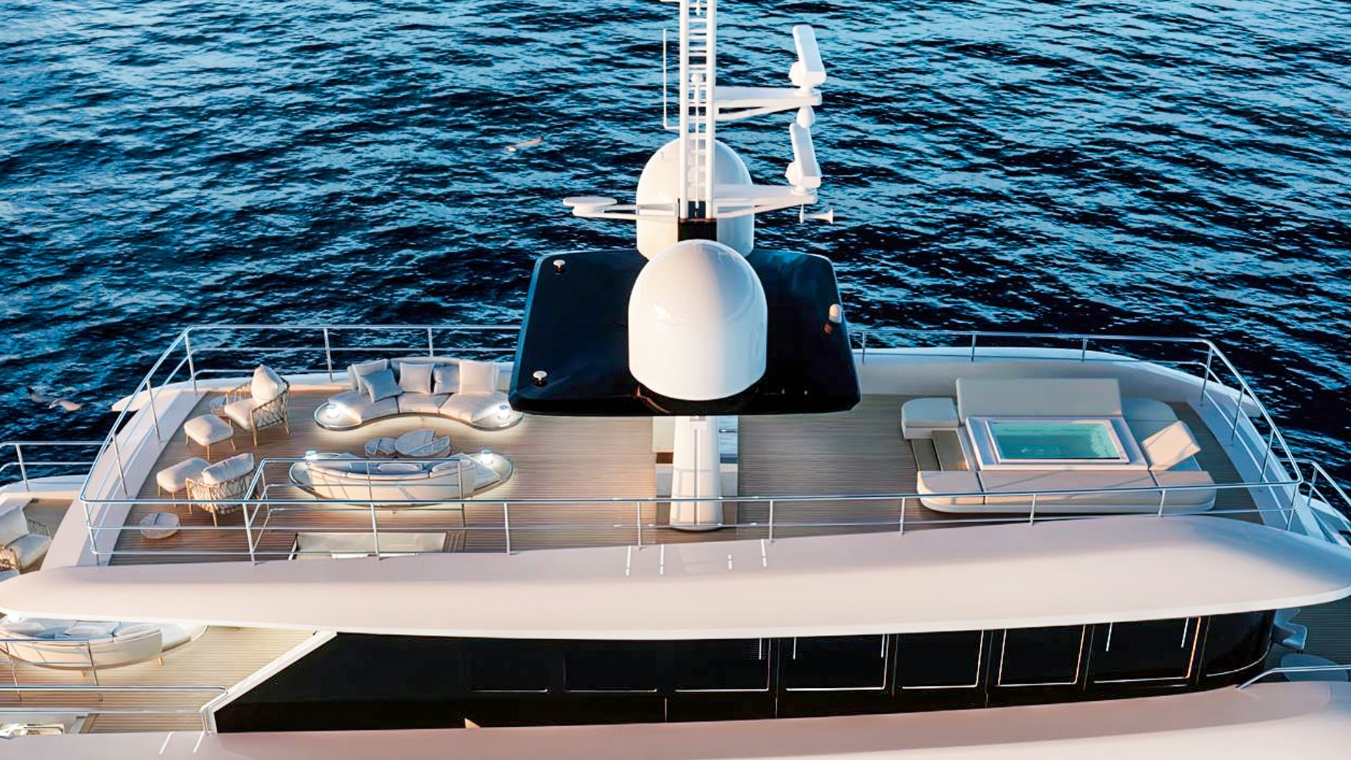
RENATA ~ CCN
1
2
3
4
5
Please note the interior design and final details may vary and are subject to change since the yacht is still being refitted during winter 2024/2025.
Brand new 2025 yacht
Six comfortable cabins
Attractive Master cabin
Experienced crew

Slide 4
OVERVIEW
RENATA ~ CCN
RENATA is undergoing a complete renewal in 2024, with a relaunch planned for spring 2025, transforming her into a practically new yacht. Initially delivered in 2018, she faced a significant force majeure accident during her delivery period, which led to a complete rebuild from the hull up. The technical relaunch was in June 2024, with charters available starting from June 2025.
The yacht features six spacious cabins that can accommodate up to twelve guests, thanks to her wide-body design. The interior design has been carefully crafted to complement her sleek new exteriors, with special attention given to the Master cabin, which is located on a separate deck and boasts a private jacuzzi along with spectacular views.
At 40.80 meters in length and cruising at a relaxed 11 knots, RENATA offers an ideal blend of style and comfort for an unforgettable getaway at sea. The Master suite is a standout feature, occupying its own private deck with a balcony that includes a jacuzzi on one side and an intimate seating area on the other—perfect for morning coffee or sunset cocktails. On the lower deck, there are four double cabins and one twin cabin, all equipped with en-suite bathrooms, ensuring every guest enjoys their own private retreat.
The main deck features an elegant salon, ideal for relaxation or socializing, as well as a fully equipped galley prepared to serve delicious meals. The captain’s cabin and bridge are also located here, ensuring the captain is close to the action.
RENATA’s sundeck is designed for soaking up the sun and enjoying the sea breeze, offering a shaded lounge area, bar, barbecue, and an additional jacuzzi—perfect for afternoon relaxation. With ample seating and stunning sea views, it’s an excellent spot for sunbathing. For those seeking extra indulgence, RENATA also boasts a beach club, a sauna, and a spacious swim platform, ideal for water sports or simply lounging by the sea.

Slide 5
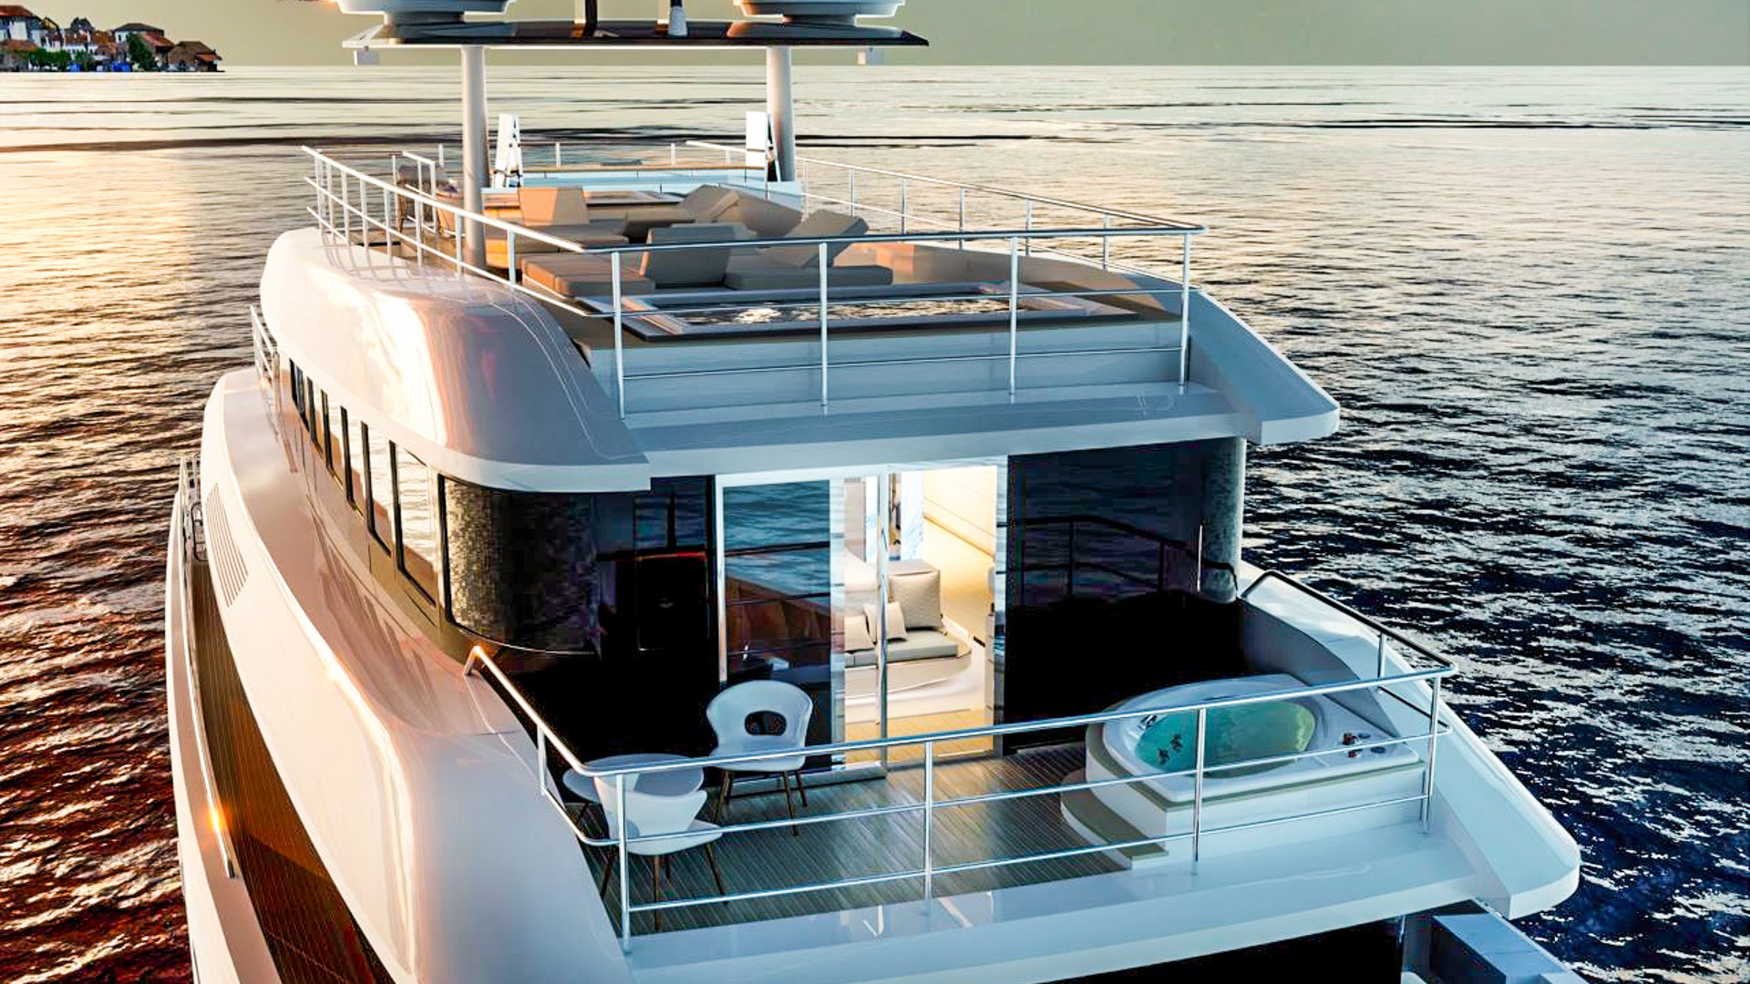
RENATA ~ CCN
Deck Jacuzzi

Slide 6
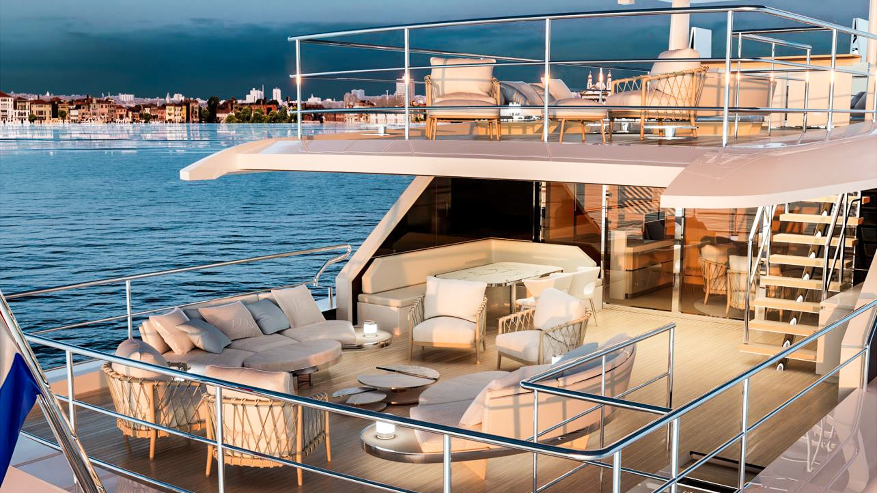
RENATA ~ CCN
Deck aft

Slide 7
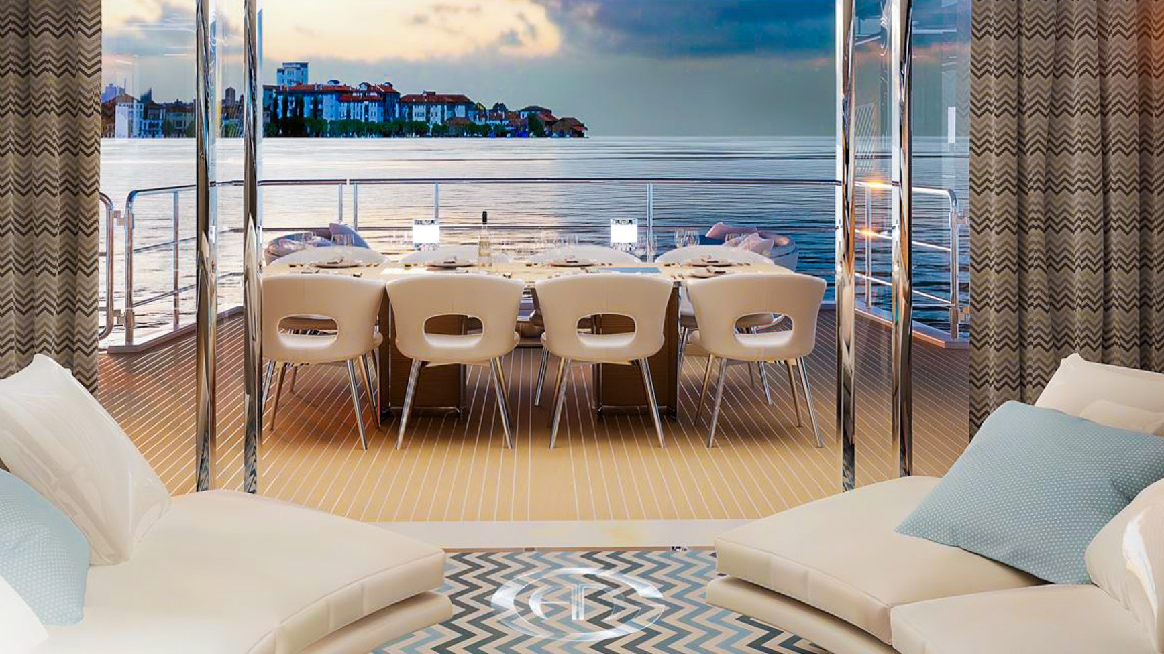
RENATA ~ CCN
Aft view

Slide 8
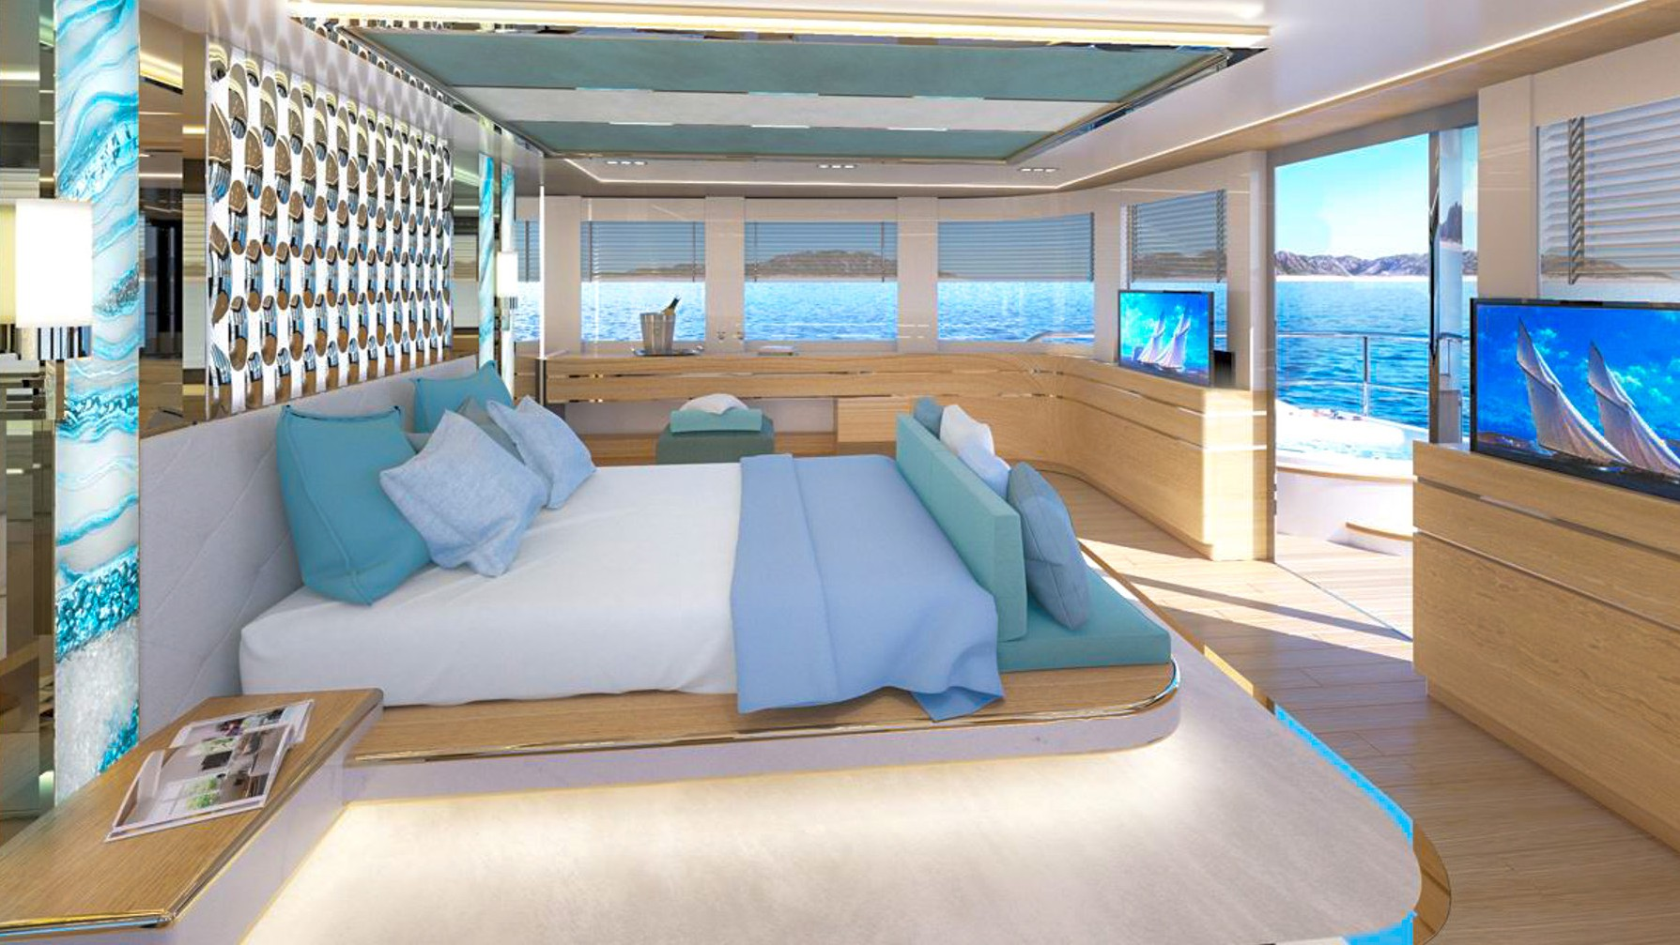
RENATA ~ CCN
Master Suite View

Slide 9
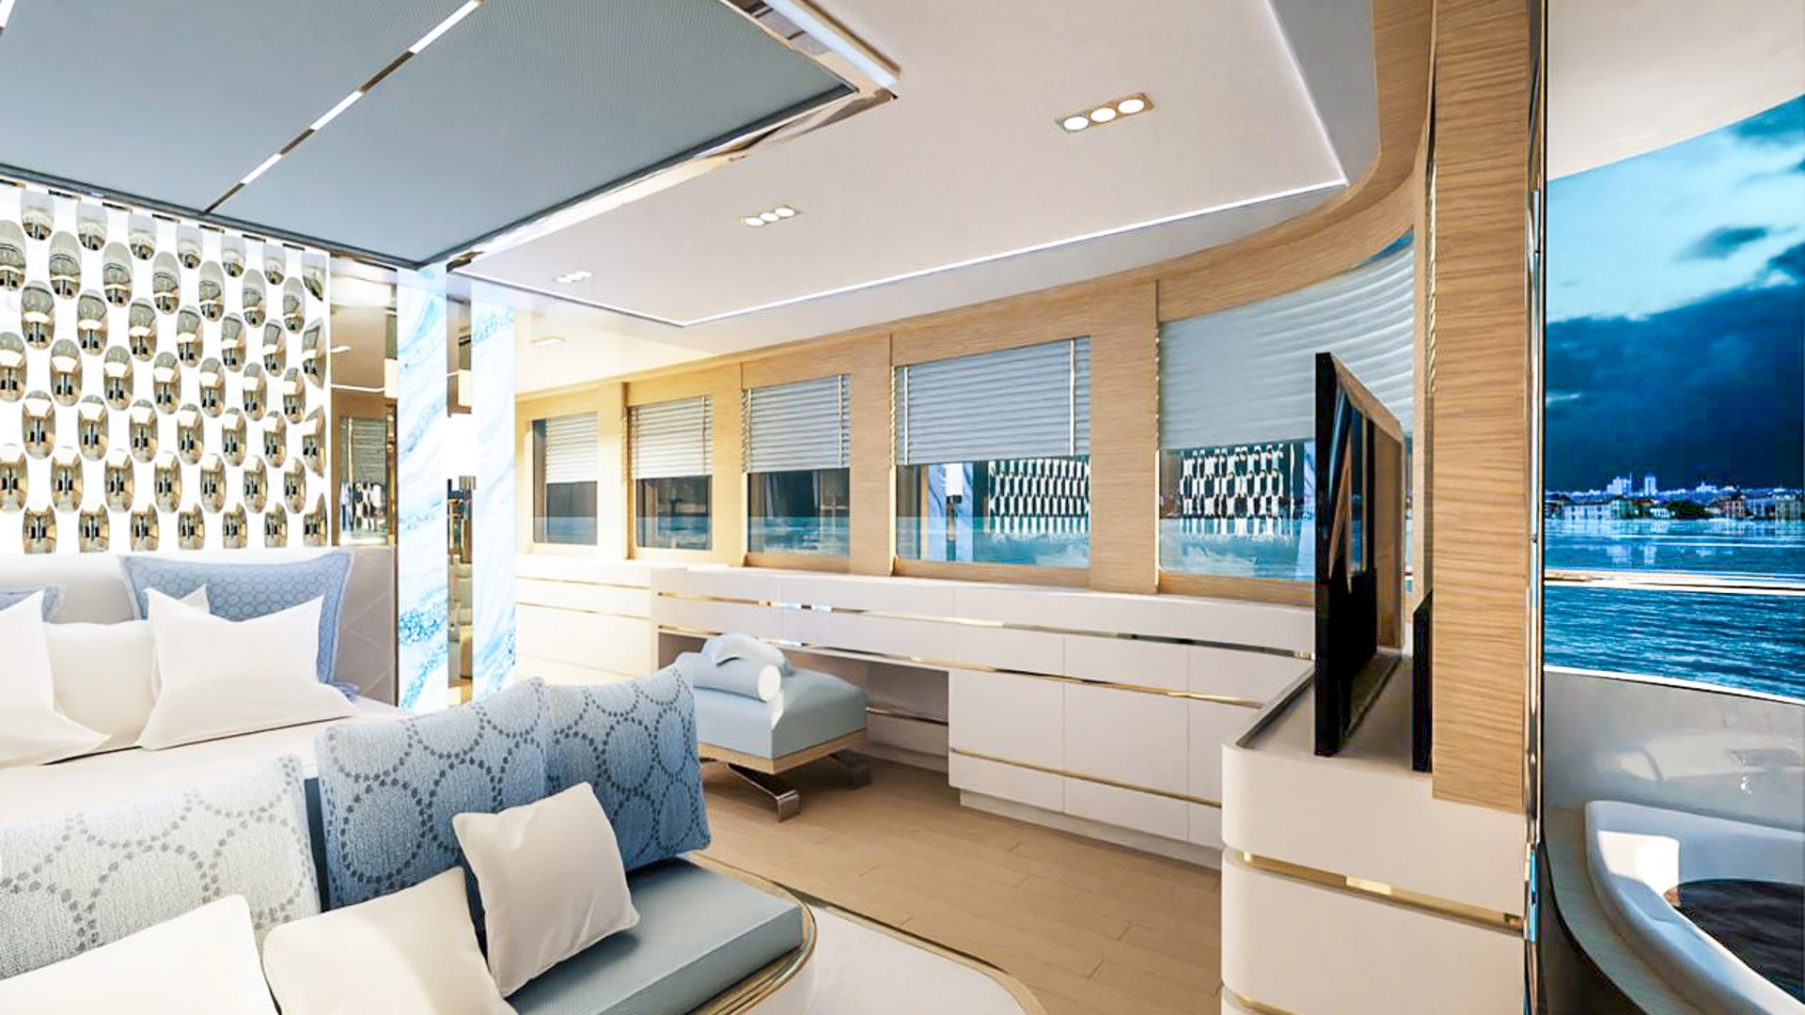
RENATA ~ CCN
Master Suite

Slide 10
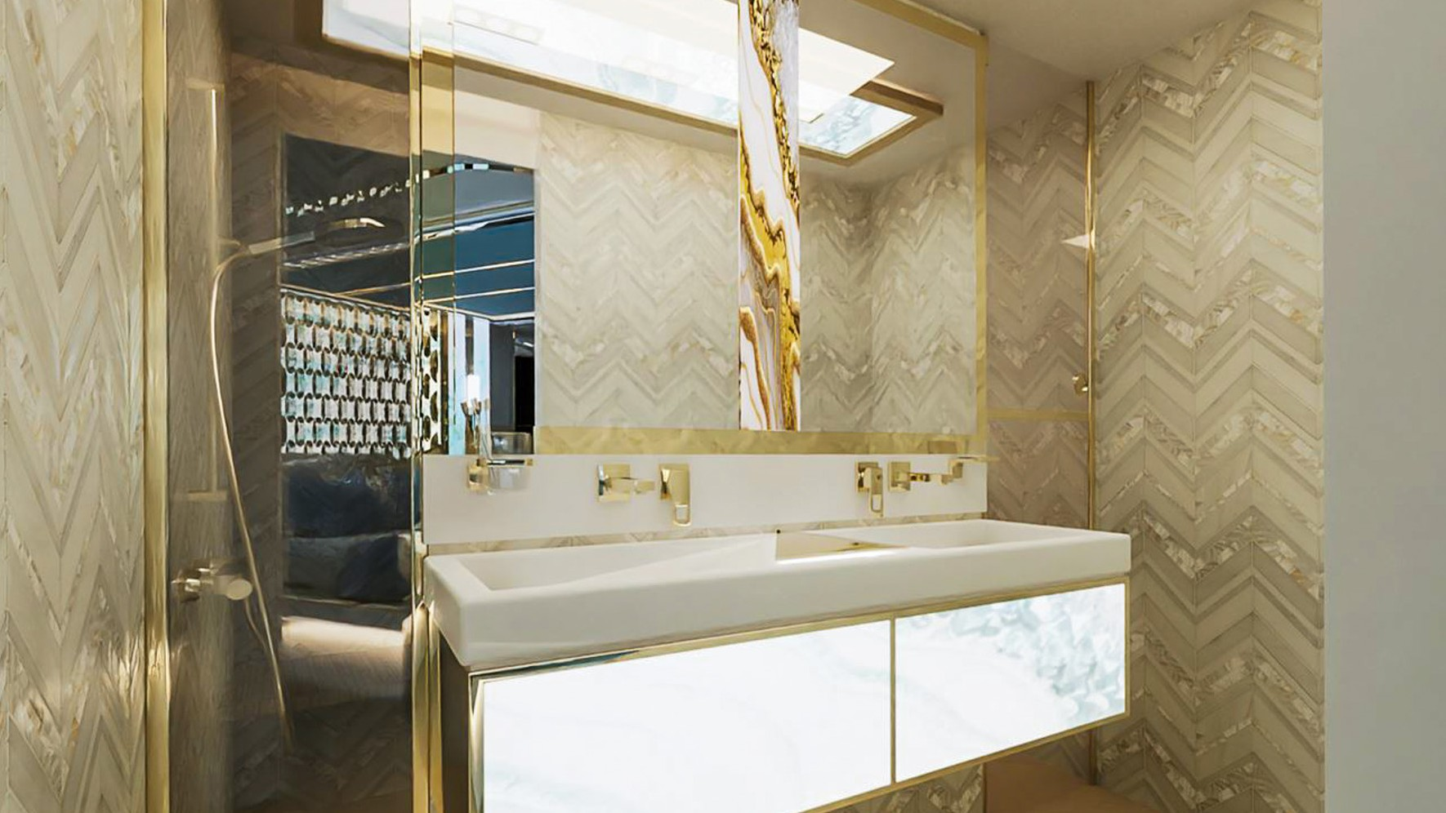
RENATA ~ CCN
Ensuite

Slide 11
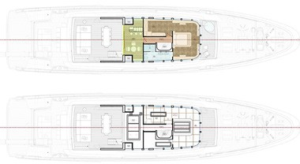
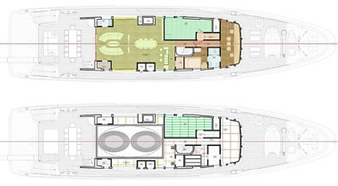
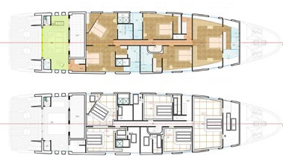
RENATA ~ CNN
General arrangement

Slide 12
TECHNICAL SPECIFICATIONS
RENATA ~ CCN
Loa 40.80 m (133’ 10”)
Beam 9.00 m (29’ 6”)
Draft 2.6 m (8’ 6”)
Guests 12
Cabins 6
Cabin configuration 5 Double Cabins
Bed configuration 5 Queen Beds, 2 Single Beds
Engines Caterpillar Inc C32 Acert 1800 KW 2414 HP X 2 Generators KOHLER 3 x 75 KW Cruising speed 12 knots
Fuel Consumption 300 Litres/Hr

Slide 13
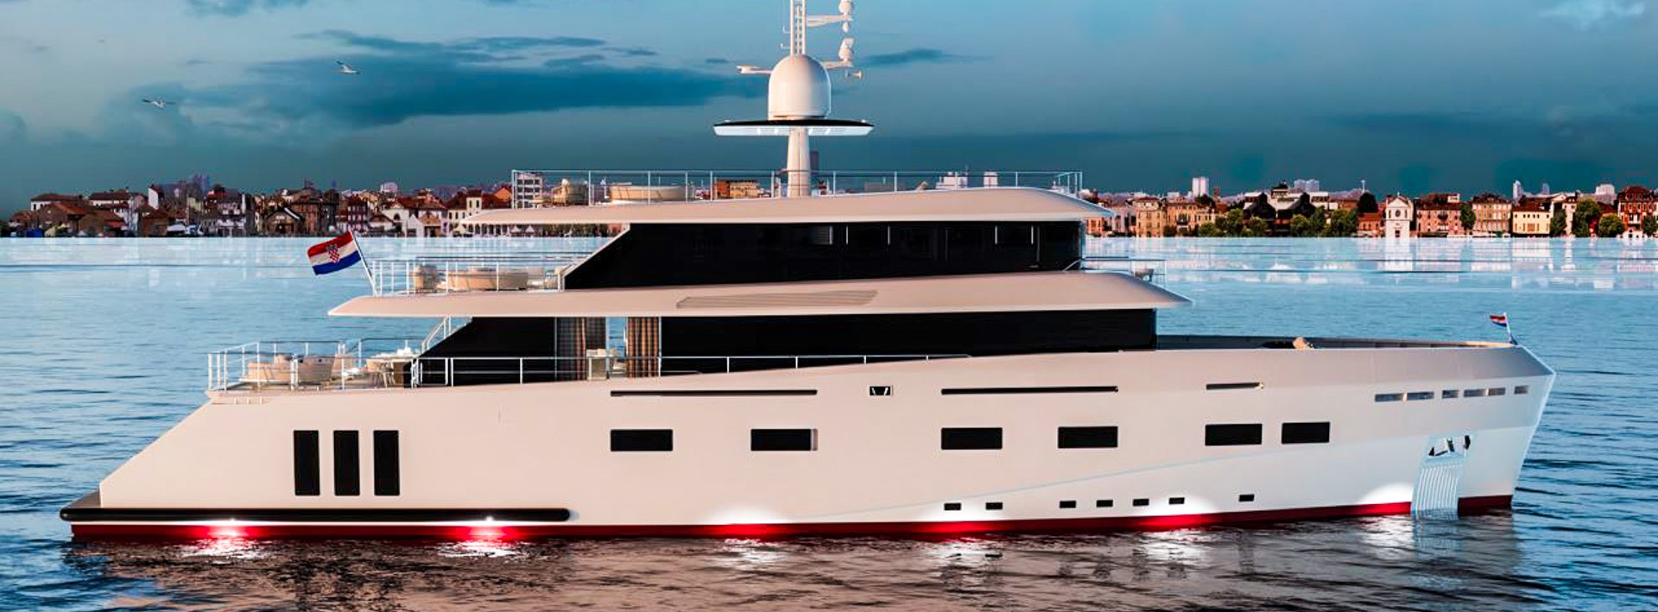
TENDER & SEA TOYS
RENATA ~ CCN
Chase boat Tender with LOA 10 m equipped with Mercury Verado 2 x 300hp ◇ Crew tender 1 x Jet ski Seadoo RXP-X Apex 300 Audio ◇ 1 x Jet ski Seadoo GTX LTD 300 iDF Audio

Slide 14
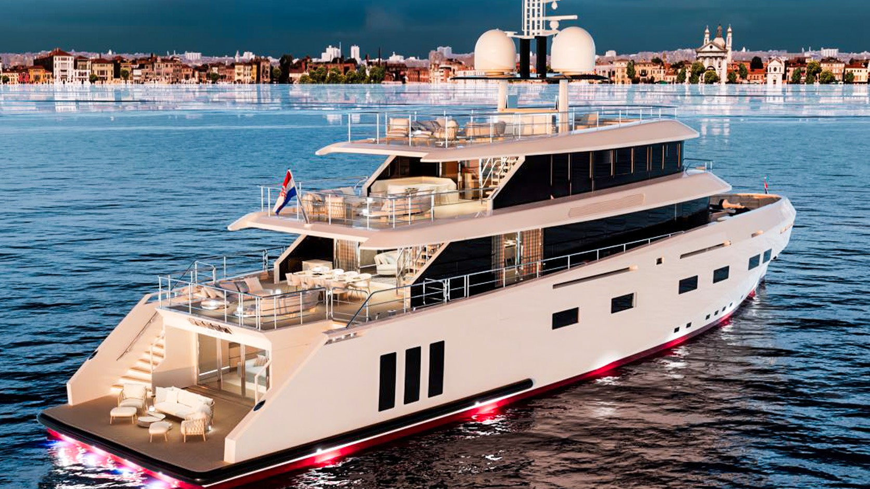
RENATA ~ CCN
We invite you to discover fascinating Croatia with us!

